Slide 1
Unit 5 Lesson 3 I can talk about traveling in an airport or train station

Slide 2
Think about your last vacation to practice
the following prompts:

Slide 3
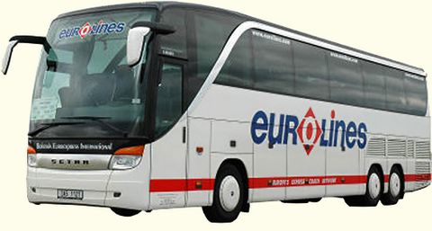
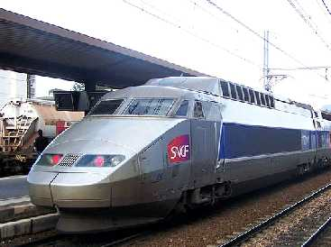
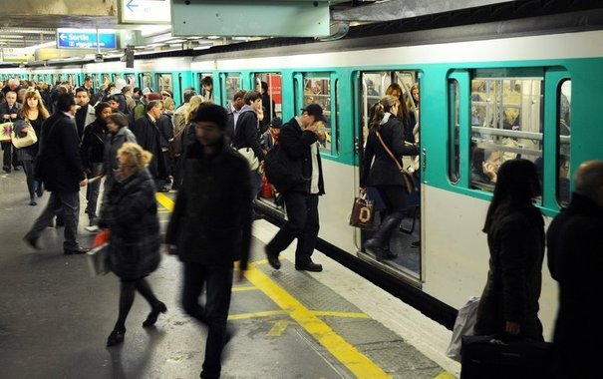
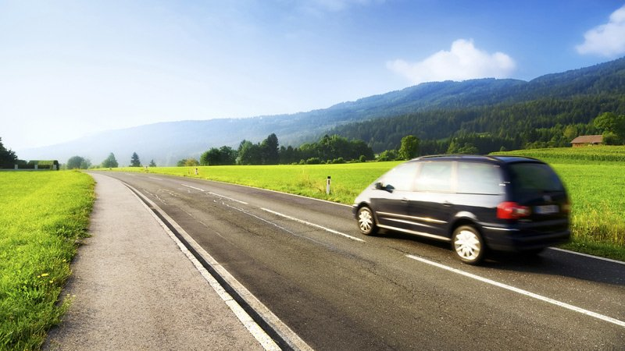
Comment est-ce que tu y es allé(e)?
J’y suis allé(e)…
en bus
en métro
en train
en voiture

Slide 4
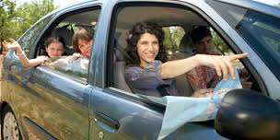
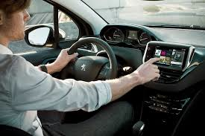
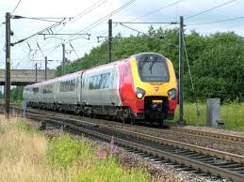
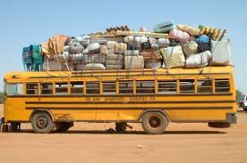
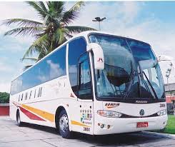
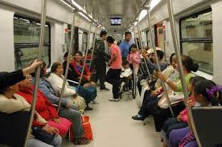
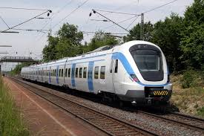
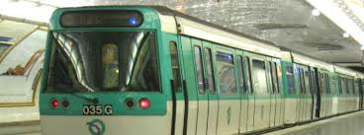
J’y vais…
J’y suis allé(e)…
maintenant
hier

Slide 5
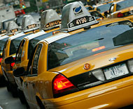
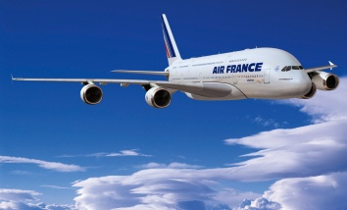
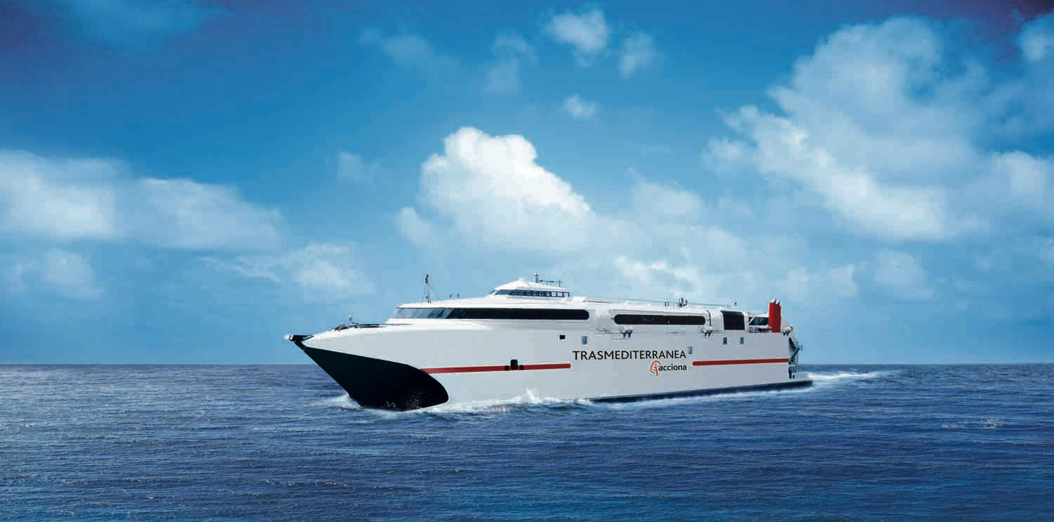
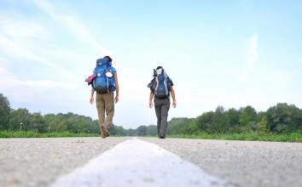
en avion
en taxi
en bâteau
à pied

Slide 6
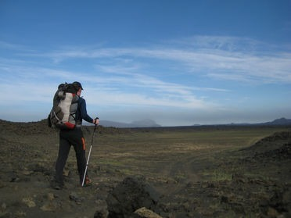
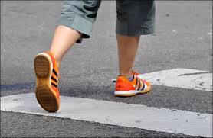
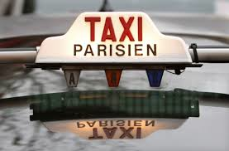
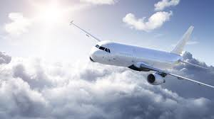
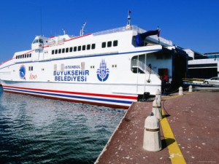
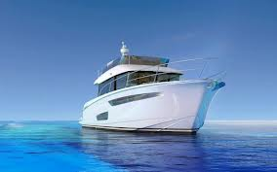
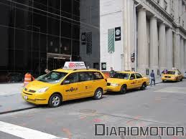
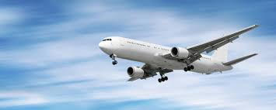
J’y vais…
J’y suis allé(e)…
maintenant
hier

Slide 7
STEP #1- Write about your last trip on the handout Include the following 4 details:
Where you went Où es-tu allé
How you went there Comment est-ce que tu y es allé?
What you did Qu’est-ce que tu as fait?
Who you went with Avec qui es-tu allé?
STEP #2- Interview 2 of your neighbors to find out about their trips.
Listen carefully and write down the 4 required details!

Slide 8
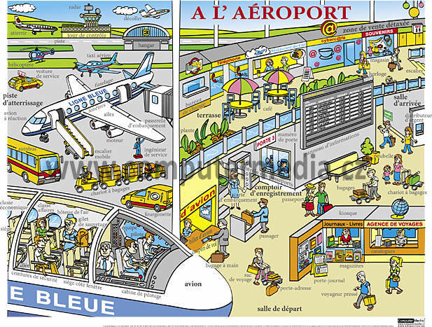
EN AVION
Qu’est-ce que tu as fait à l’aéroport?

Slide 9
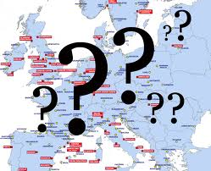
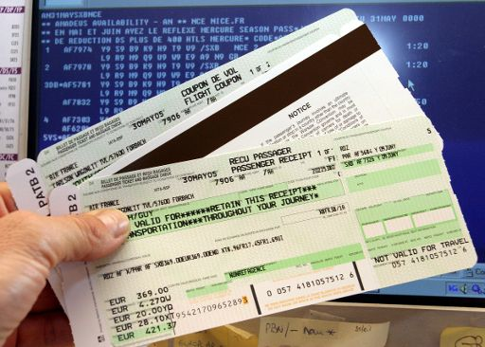
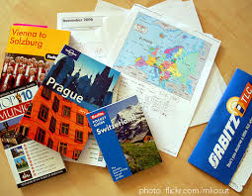
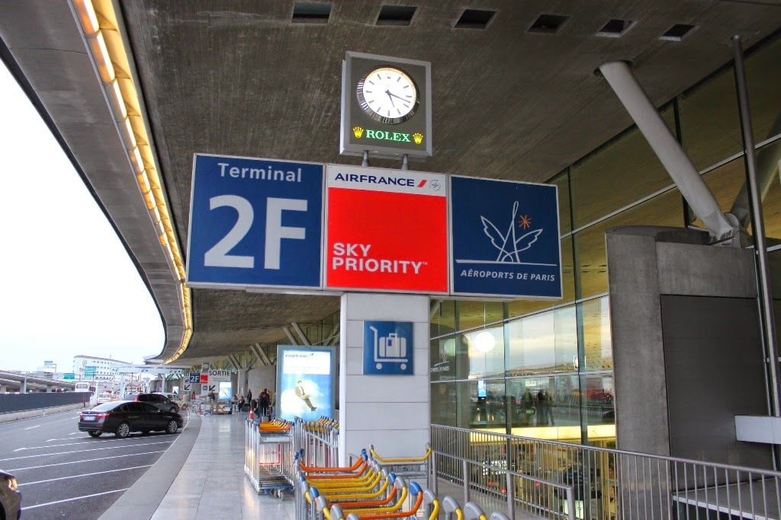
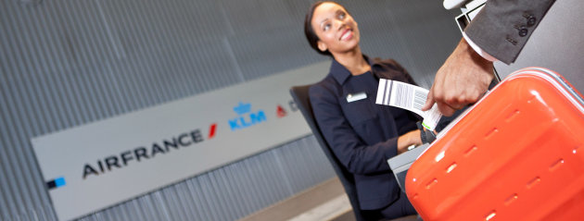
planifier le voyage
acheter un billet
arriver à l’aéroport
enregistrer les bagages

Slide 10
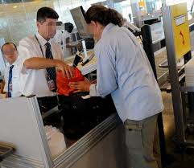
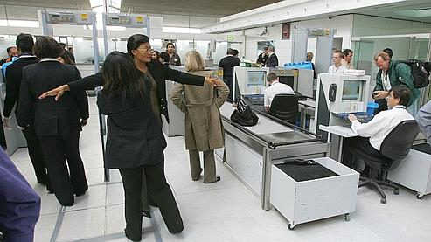
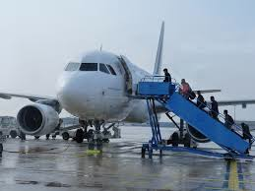
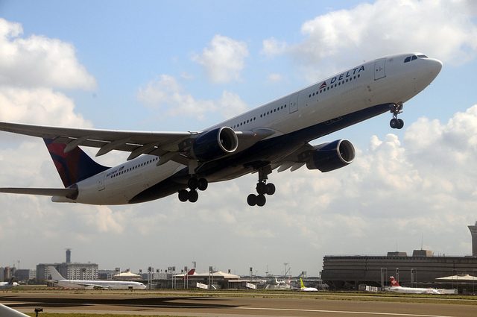
inspecter les bagages
passer par sécurité
embarquer l’avion
décoller

Slide 11
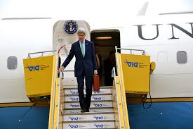
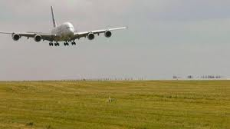
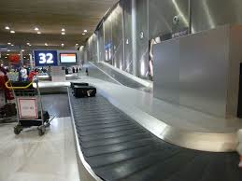
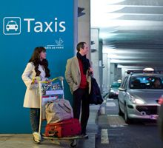
attérir
débarquer l’avion
réclamer les bagages
partir de l’aéroport

Slide 12
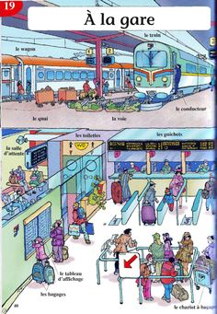
Qu’est-ce que tu as fait à la gare?

Slide 13
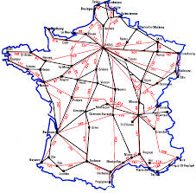
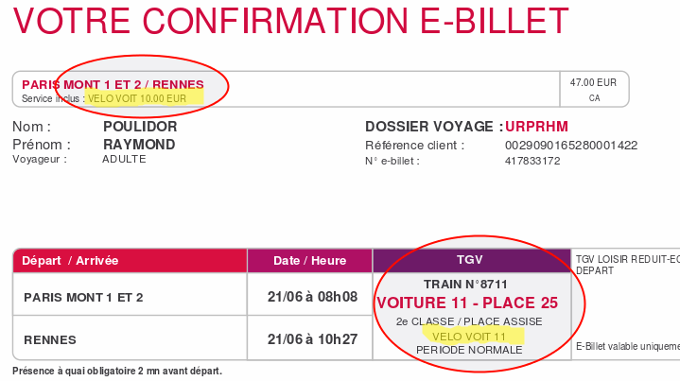
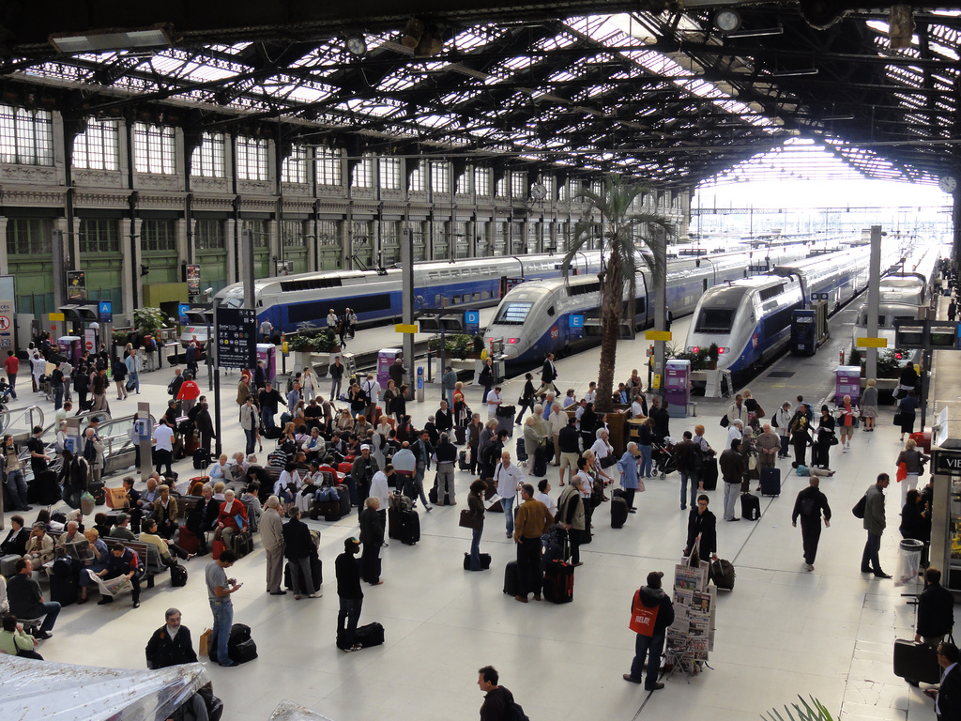
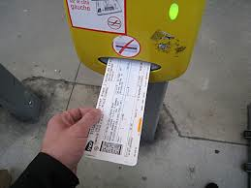
planifier
réserver une place
attendre le train
composter le billet

Slide 14
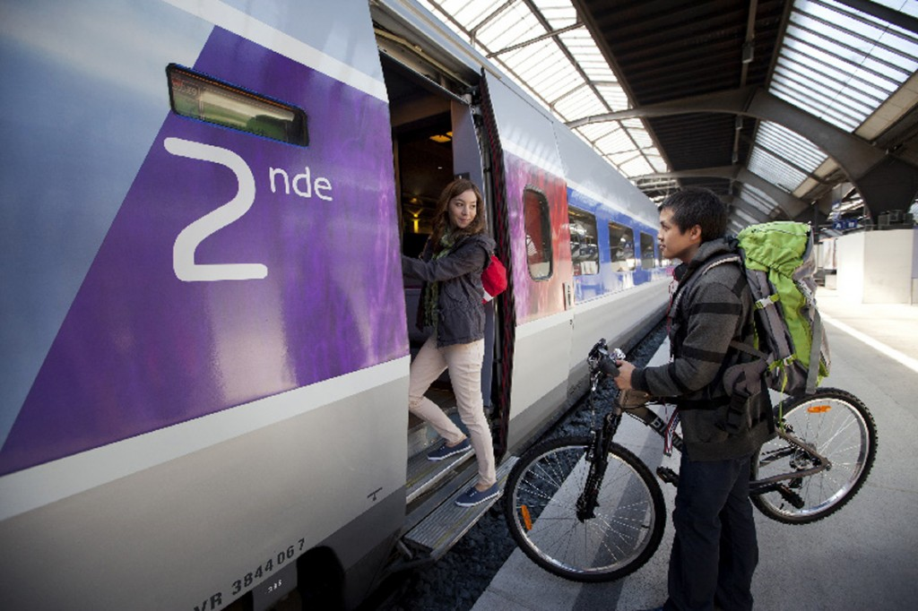
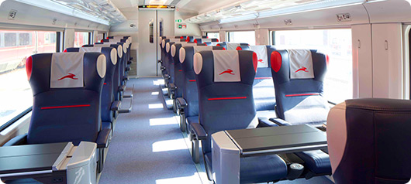
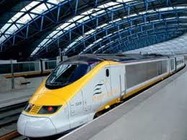
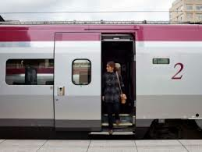
monter le train
chercher un siège
revenir de…
descendre le train

Slide 15
JEU De Pratique
Cut out the vocab cards.
Every student needs a whiteboard and marker.
Play memory.
When you find a match, you must use it correctly in a sentence in the past tense in order to keep the match.

Slide 16
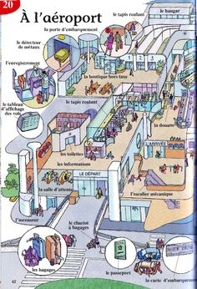
EN AVION

Slide 17
Cultural Differences
Where to buy a ticket?
Long journeys vs short journeys
Changing stations / train travel in general
Where to check in?
Luggage?
1st or 2nd class?
Overnight trains
Notes:
http://www.seat61.com/Europe-train-travel.htm#Do_I_need_to_check-in_for_a_train

Slide 18
DAY 2
J’ai un problème

Slide 19
LA CLOCHETTE
Use the Passé Composé!
Where did you go?
My sister and I, went to Brussels.
How did you go there?
We went there by plane.
We planned the trip and bought two tickets.
We arrived at the airport and we checked our bags.
We passed by security; they did not inspect my purse.
We boarded the plane and the plane took off.

Slide 20
Comment est-ce que tu y es allé(e)?
J’y suis allé(e)…
en bus
en métro
en train
en voiture

Slide 21
J’y vais…
J’y suis allé(e)…
maintenant
hier

Slide 22
en avion
en taxi
en bâteau
à pied

Slide 23
J’y vais…
J’y suis allé(e)…
maintenant
hier

Slide 24
planifier le voyage
acheter un billet
arriver à l’aéroport
enregistrer les bagages

Slide 25
inspecter les bagages
passer par sécurité
embarquer l’avion
décoller

Slide 26
attérir
débarquer l’avion
réclamer les bagages
partir* de l’aéroport

Slide 27
STEP #1- Write about your own trip. Use the prompts given to say:
-Where you went
-How you went there
-What you did
STEP #2- Interview 2 of your neighbors to find out about their trips.
Listen carefully to them tell about with whom they went!

Slide 28
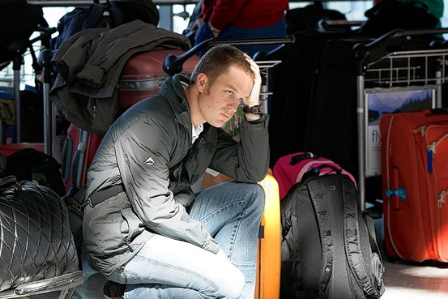
Qu’est-ce qu’il y a?
JJ’ai un problème

Slide 29
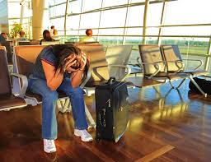
RATER
J’ai raté le vol!
J’ai raté le train!

Slide 30
PERDRE
?
J’ai perdu le billet!
J’ai perdu mon passeport!
J’ai perdu mes bagages!

Slide 31
ANNULER
Le vol est annulé!
Le train est annulé!

Slide 32
OUVERT(e)
FERMÉ(e)
L’aéroport n’est pas ouvert!
La gare est fermée!

Slide 33
Je ne suis pas prêt(e)!
Je suis en avance!
Je suis à l’heure!
Je suis en retard!

Slide 34
C’est interdit de texter!
Il faut être patient(e)!

Slide 35
In class writing activity

Slide 36
Listening Script:
#1
#2
#3
Listening Script:
#1 Je suis allé à Genève pour les vacances. J’ai bien planifié le voyage, mais il y avait un problème. J’ai perdu mes bagages et j’étais en retard. Heureusement, le train n’était pas à l’heure.
#2 Ce week-end nous allons à la campagne. Nous allons y aller en voiture et faire une promenade dans la forêt. Il y a une grande rivière qui termine dans un lac. Nous allons nager et bronzer à la plage.
#3 Christophe n’est pas prêt pour le travail aujour’dhui. Il est allé a NY pendant le weekend. Il a enregistré les bagages est passé par sécurité à l’aéroport. Il a aimé le voyage, mais quand il est rentré, il est tombé dans la rue et il est allé à l’hôpital.

Slide 37
5.3.3
I can talk about my last trip.

Slide 38
LA CLOCHETTE
Where did you guys go for the trip?
My parents and I, we went to Montreal.
How did you guys go there?
We went there by train and by boat.
We reserved 2 places and arrived at the train station.
What’s wrong? Did you guys miss the boat?
No, but I lost my ticket and the boat was cancelled.
You need to be patient and be on time.

Slide 39
Qu’est-ce qu’il y a?
JJ’ai un problème

Slide 40
RATER
J’ai raté le vol!
J’ai raté le train!

Slide 41
PERDRE
?
J’ai perdu le billet!
J’ai perdu mon passeport!
J’ai perdu mes bagages!

Slide 42
ANNULER
Le vol est annulé!
Le train est annulé!

Slide 43
OUVERT(e)
FERMÉ(e)
L’aéroport n’est pas ouvert!
La gare est fermée!

Slide 44
Je ne suis pas prêt(e)!
Je suis en avance!
Je suis à l’heure!
Je suis en retard!

Slide 45
C’est interdit de texter!
Il faut être patient(e)!

Slide 46
In class writing activity

Slide 47
Listening Activity
Listen to the following people talk about a recent trip they took.
Circle the things you hear.
Compare with your partner.

Slide 48
Listening Script:
#1
#2
#3
Listening Script:
#1 Je suis allé à Genève pour les vacances. J’ai bien planifié le voyage, mais il y avait un problème. J’ai perdu mes bagages et j’étais en retard. Heureusement, le train n’était pas à l’heure.
#2 Ce week-end nous allons à la campagne. Nous allons y aller en voiture et faire une promenade dans la forêt. Il y a une grande rivière qui termine dans un lac. Nous allons nager et bronzer à la plage.
#3 Christophe n’est pas prêt pour le travail aujour’dhui. Il est allé a NY pendant le weekend. Il a enregistré les bagages est passé par sécurité à l’aéroport. Il a aimé le voyage, mais quand il est rentré, il est tombé dans la rue et il est allé à l’hôpital.

Slide 49
Speaking activity
Partner 1: You have 1 minute to talk about a recent trip you took.
Partner 2: Circle the words your partner uses.
Reverse roles.
Partner 2: You have 1 minute to talk about a recent trip you took.
Partner 1: Circle the words you hear.
Whoever has the most right wins the point.

Slide 50
Speaking activity
Use the vocab chart to help prepare a narration of the last trip you took by plane.
You have 1 minute to prepare.
You have 1 minute to present.
Now work with a partner. Ask and answer questions about this trip.

Slide 51
Cultural Differences
Where to buy a ticket?
local/regional is price fixed
buy online, phone, in person
Long journeys vs short journeys
Changing stations
short distance = 10 min
long distance / reserved = 30 min-1 hour
Notes:
http://www.seat61.com/Europe-train-travel.htm#Do_I_need_to_check-in_for_a_train

Slide 52
Cultural Differences
Where to check in?
no security – except for Eurostar
Luggage?
no bag checks – carry and store yourself
1st or 2nd class?
not a big difference on most trains
Overnight trains
Notes:
http://www.seat61.com/Europe-train-travel.htm#Do_I_need_to_check-in_for_a_train

Slide 53
5.3.4 Unit 5 Review

Slide 54
UNIT 5 Review DAY
LA CLOCHETTE
1. What is your city like and what do you like to do there?
2. In my city, there is a downtown. I like to shop in the best
store
3. How do you get to the airport? When is it open?
Turn left and go straight. It is closed now.
What did you guys do on your trip to Montreal?
We went to a club and we danced.
How did you get there and what did you do?
We went by plane, but it was late. We had to
change our tickets

Slide 55
Directions
Work with a partner to get from point A to point B in French
Choose a starting and ending point
Use the command
Use the vocabulary from 5.1
Write on the whiteboards
Compare answers

Slide 56
Le présent, le passé et le futur
Je fais Colored Die
J’ai fait 1,2= présent
Je vais faire 3,4= passé
5,6= futur
Nous tombons
Nous sommes tombés White Die
Nous allons tomber 1=je 2=tu 3=elle
- 4=nous 5=vous 6=ils

Slide 57
Listening Activity
Listen to the following people talk about a recent trip they took.
Circle the things you hear.
Compare with your partner.

Slide 58
Listening Script:
#1
#2
#3
Listening Script:
#1 Je suis allé à Genève pour les vacances. J’ai bien planifié le voyage, mais il y avait un problème. J’ai perdu mes bagages et j’étais en retard. Heureusement, le train n’était pas à l’heure.
#2 Ce week-end nous allons à la campagne. Nous allons y aller en voiture et faire une promenade dans la forêt. Il y a une grande rivière qui termine dans un lac. Nous allons nager et bronzer à la plage.
#3 Christophe n’est pas prêt pour le travail aujour’dhui. Il est allé a NY pendant le weekend. Il a enregistré les bagages est passé par sécurité à l’aéroport. Il a aimé le voyage, mais quand il est rentré, il est tombé dans la rue et il est allé à l’hôpital.

Slide 59
Speaking activity
Partner 1: You have 1 minute to talk about a recent trip you took.
Partner 2: Circle the words your partner uses.
Reverse roles.
Partner 2: You have 1 minute to talk about a recent trip you took.
Partner 1: Circle the words you hear.
Whoever has the most right wins the point.

Slide 60
Speaking activity
Use the vocab chart to help prepare a narration of the last trip you took by plane.
You have 1 minute to prepare.
You have 1 minute to present.
Now work with a partner. Ask and answer questions about this trip.

Slide 61
Writing Activity
Now write me a letter about your last trip.
Tell me
where you went
what you did
what you didn’t do
who you went with
how you got there
Use as much detail as possible and make sure
it is in the past.

Slide 62
Interpersonal Speaking
Remember to ask and answer questions. Be prepared to answer any questions your partner may ask. Talk with your partner about the following things.
your city
describe it
what is there to do?
where do people hang out?
compare your city other cities
give directions from your house to one of your favorite destinations
what forms of transportation do people use most?
how do you use the airport or train station of your area?

Slide 63
Cultural Differences
Where to buy a ticket?
local/regional is price fixed
buy online, phone, in person
Long journeys vs short journeys
Changing stations
short distance = 10 min
long distance / reserved = 30 min-1 hour
Notes:
http://www.seat61.com/Europe-train-travel.htm#Do_I_need_to_check-in_for_a_train

Slide 64
Cultural Differences
Where to check in?
no security – except for Eurostar
Luggage?
no bag checks – carry and store yourself
1st or 2nd class?
not a big difference on most trains
Overnight trains
Notes:
http://www.seat61.com/Europe-train-travel.htm#Do_I_need_to_check-in_for_a_train

Slide 65
TON VOYAGE DE RÈVE
You will be creating your dream vacation.
-Choose a destination
-Tell me about the city or location.
-Choose methods of travel
Plan the following into 3 days
-Choose 5 things you will do there
-Choose 3 things you will not do while there.
-where you will eat and what you will eat there.
-3 tourist sites where you will go.
DAY 1 travel to paris by plane take the metro while there see the eiffel tower and climb the stairs don’t do homework sleep in a hotel | DAY 2 -go to the arc de triomphe -eat lunch -walk around the park -don’t watch TV -watch a movie at cinema -eat dinner at a crêperie | DAY 3 visit the Louvre and see the Mona Lisa Eat an ice cream at a café -Shop at a big store -don’t go swimming -travel by train to Italy

Slide 66
Highlight incorrect parts – next class they correct their own
give themselves a score and see if it matches with mine.
Have them work in pairs – ask questions about where they went
and what they did.
(brainstorm questions first)

Slide 67
les Rédactions
Pick up your own
Anything highlighted is a mistake
Try to correct your mistakes on the back or somewhere else on the page
Give yourself a score 1-10 (see if it matches mine!)
Now, let’s learn about your trip!

